Slide 1

Digital Sign With Raspberry Pi
Philip King

Slide 2
The Project: Purpose
Build a digital sign, for business setting
Allows user to press 1 of 4 buttons
Each button calls a specific report
Report would update every 5 minutes

Slide 3
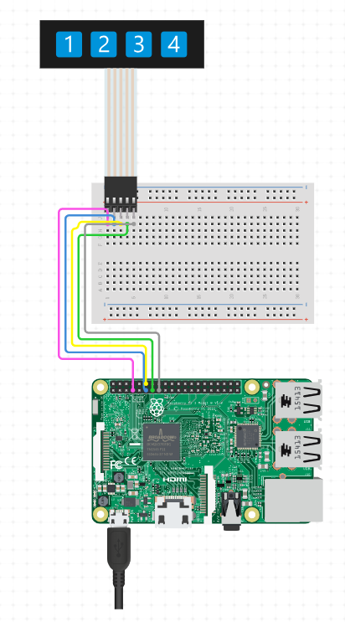
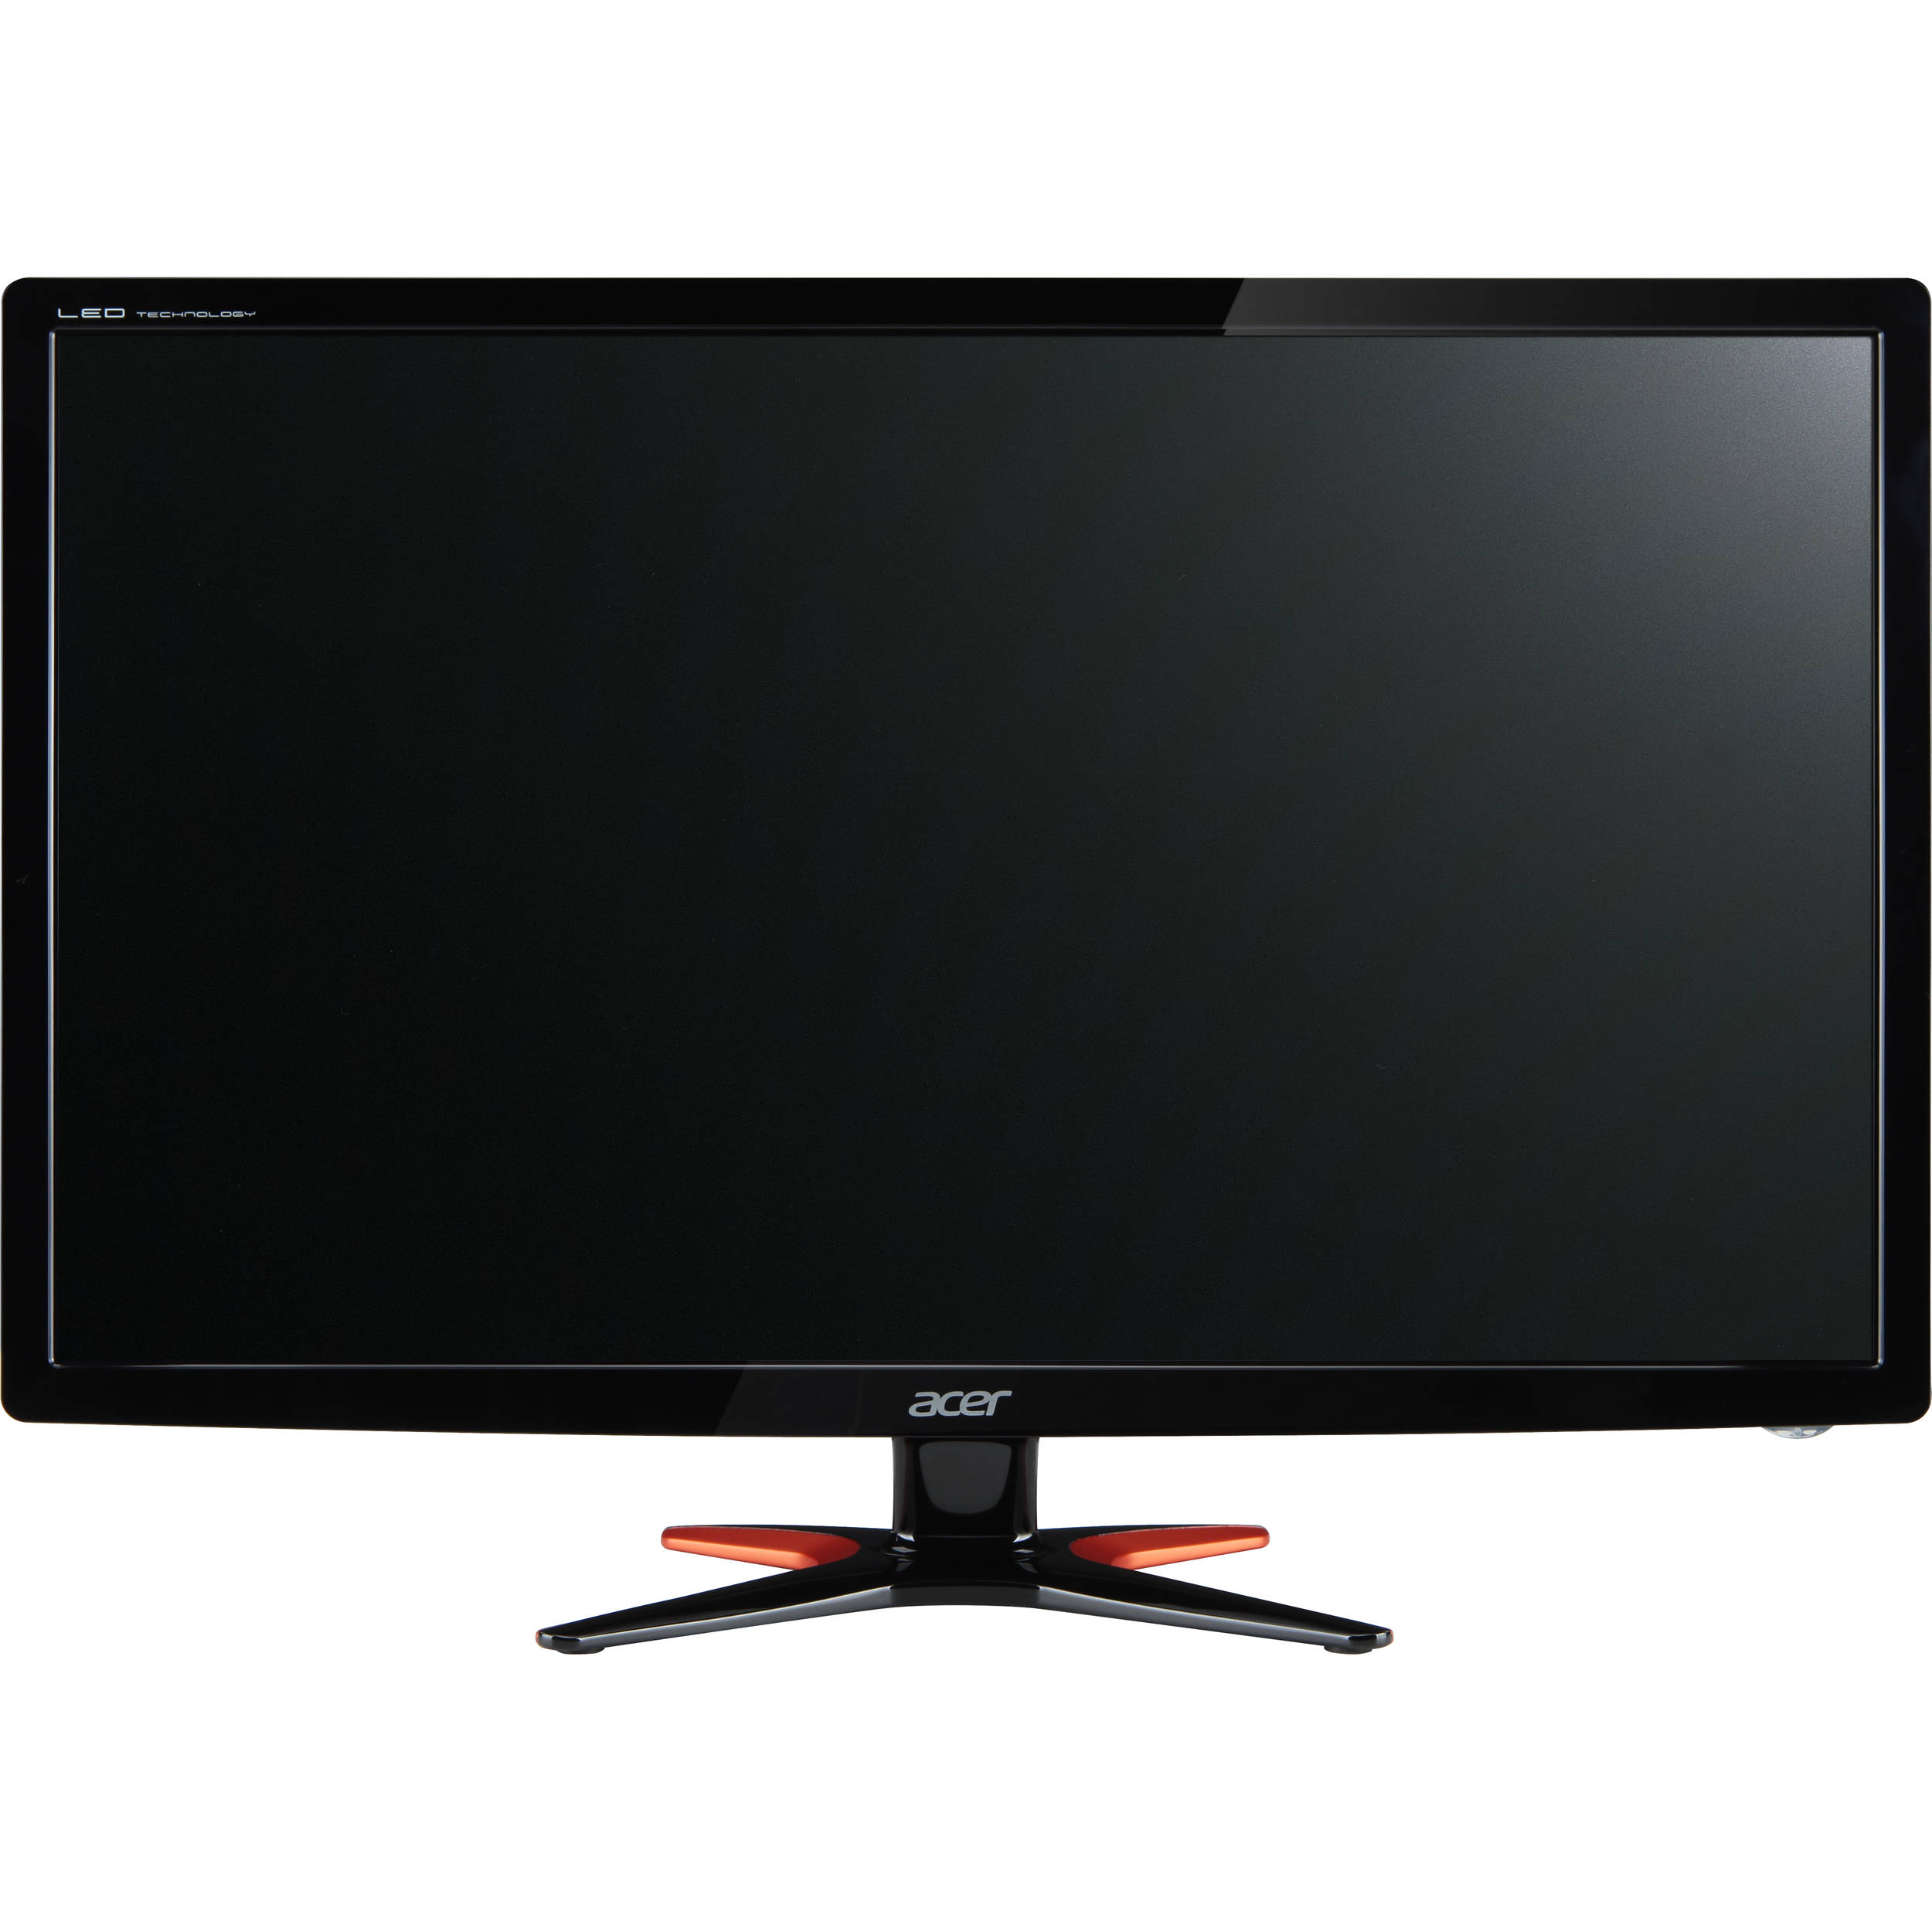
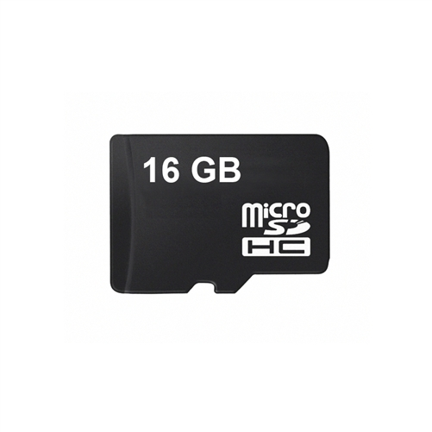
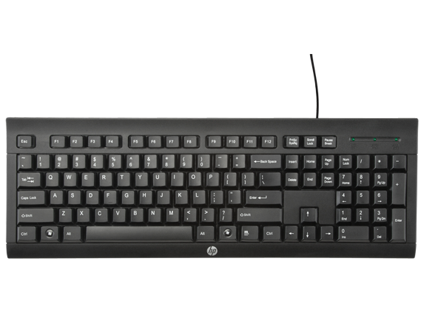

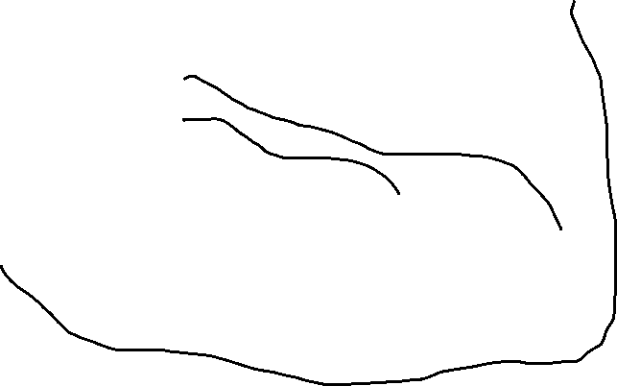
The Hardware

Slide 4
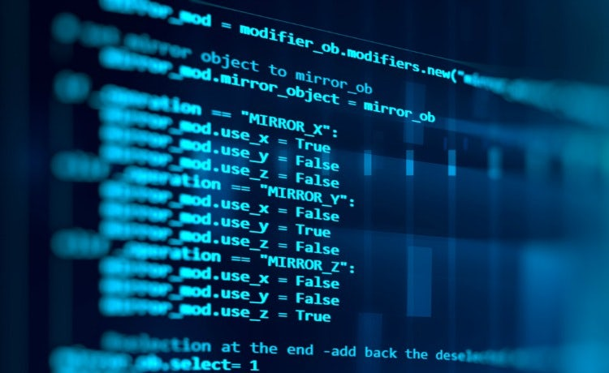
The Code
Import GPIO Library
Set which pin button wires are connected to
Assign buttons as variables
Create while loop
If button is pushed, opens website
If web browser is already open, closes previous browser and opens new website
Continues to check for buttons being pushed

Slide 5
The Process
Week | Goals | Of Note
1 | Research similar projects / hardware | Found good hardware layout of mapping with similar code, was able to use some of what was done in class
2 | Create Roadmap / Acquire Hardware | Originally thought did not need breadboard, then found that it may be needed, did not know that Raspberry Pi’s do not come with MicroSD card
3 | Create framework for code / Assemble hardware | Large amount of time spent on Ubuntu getting libraries and modules installed correctly
4 | Get buttons working / integration testing / troubleshoot hardware | Was able to wire membrane button without breadboard, ultimately decided that it was better to use another OS on the Raspberry Pi and used Raspian
5 | Final touches on code
Final | Establish RDP connection / QA code and test hardware

Slide 6
Challenges
Hardware – had not used hardware before, so ended up waiting on shipping (from Amazon) on different components – Breadboard and kit, MicroSD card, ended up buying multiple MicroSD cards to be able to get project working
Hardware is limited due to processing capabilities and should not run Selenium (very heavy development software for automated testing)
Limitations of Software, there were some assumptions made in my code design that needed to be adjusted during the development process. One of these is that python does not have a good refresh browser functionality. As a result, this was taken out of scope and added to another Java script (future) project.
Business Environment – Needs of the customer changed from when this was originally started and although it was completed, will need to be used for another application or client as original client is no longer associated.

Slide 7
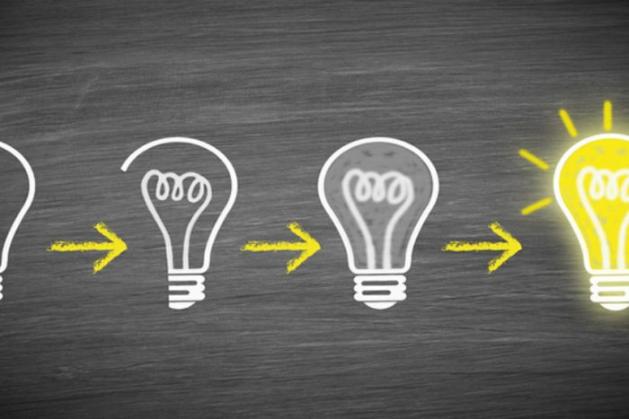
Lessons Learned
Although understanding the limitations of the code is important but. . .
Hardware must have all necessary components to complete requirements
Must take time in advance to evaluate all additional software used for effectiveness, ease of use and interdependency
Looking up additional functionality takes as long as writing and testing existing code
The associated coding and setup with the software on the Raspberry Pi OS originally selected, Ubuntu took significant effort to learn as I had not used this before

Slide 8
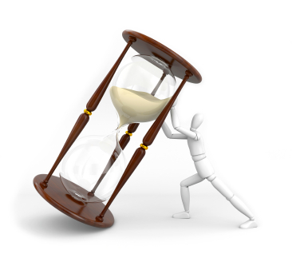
If I had more time. . .
Add link to Java script on local browser and write Java script to refresh browser
Create more advanced titling, that is more descriptive than “Button 1 pushed”
Build more aesthetically pleasing case / hide ribbons connecting push button to the Raspberry Pi
Create better looping that does not have config errors (code works).

